Slide 1



Slide 2







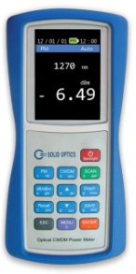

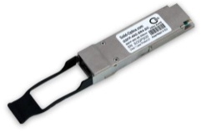

Who are we?
Foundation
Alturna Networks B.V
Creation of Research and Development
Solid-Optics
Launch and Marketing of the brand gamme
Solid Optics
2006
2007
2010

Slide 3
Scope of activity / numbers

Slide 4

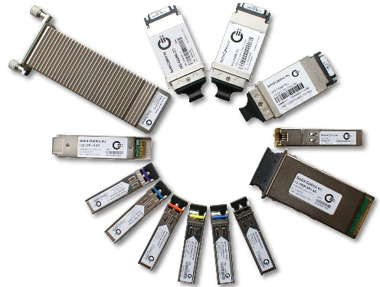






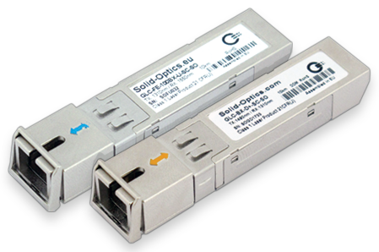
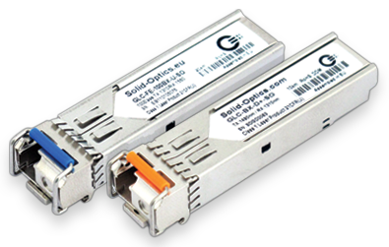



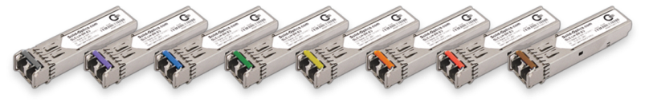
PRODUCT LINES
Compatible Optics
BiDi / FttH
CWDM/DWDM & MUX/OADM

Slide 5
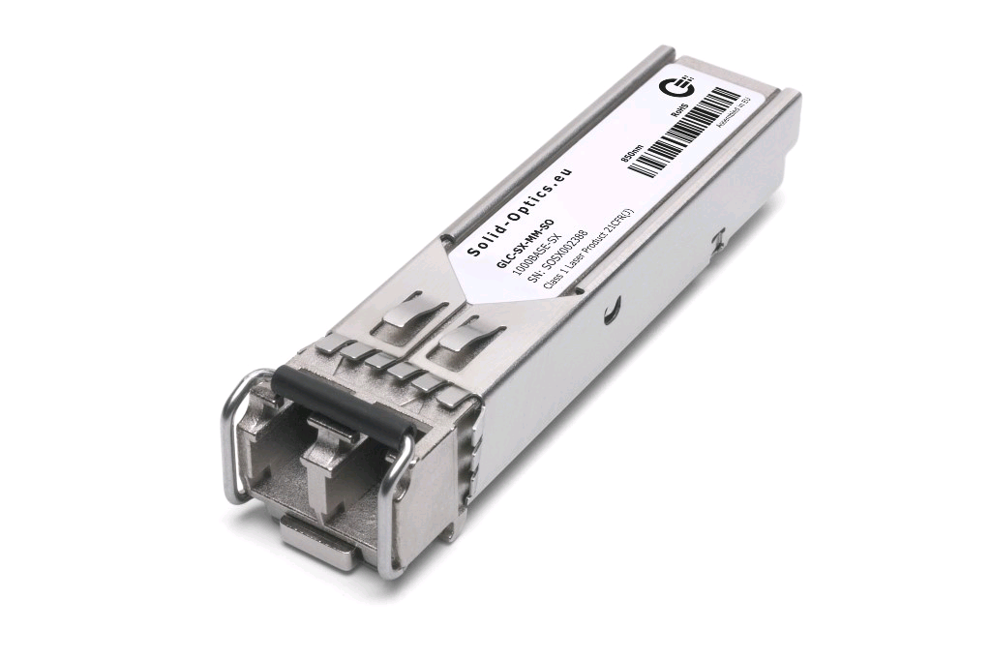


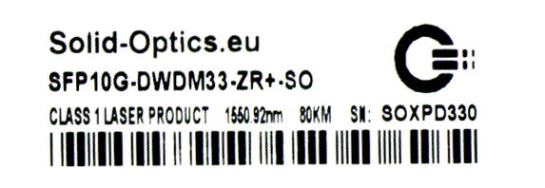
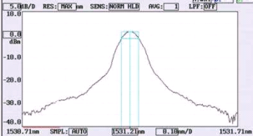
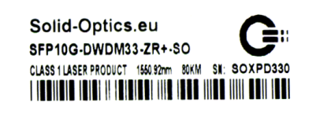


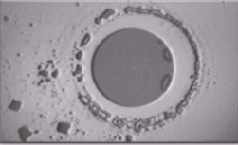
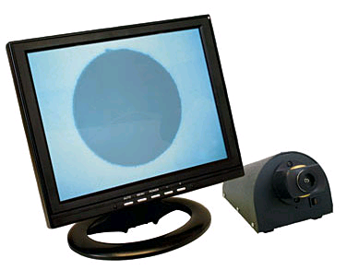

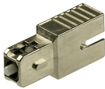
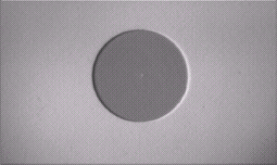
OPTIC
TESTING
Compatibility
15xx.xxnm
Label Contents
CWDM/DWDM
Laser Color / Nanometer
EEPROM Contents
FULL 10G Traffic Test
Lens inspection
& Cleaning
With Attenuation
Tx power
Rx power
xx dB

Slide 6
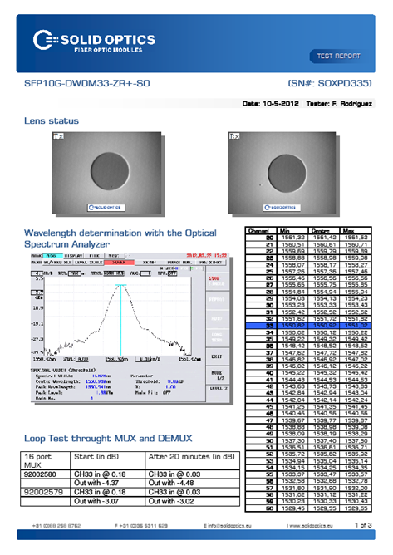
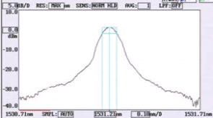
Lens inspection
& Cleaning
Color
15xx.xxnm
CWDM/DWDM
With Attenuation
xx dB
Tx power
Rx power

Slide 7
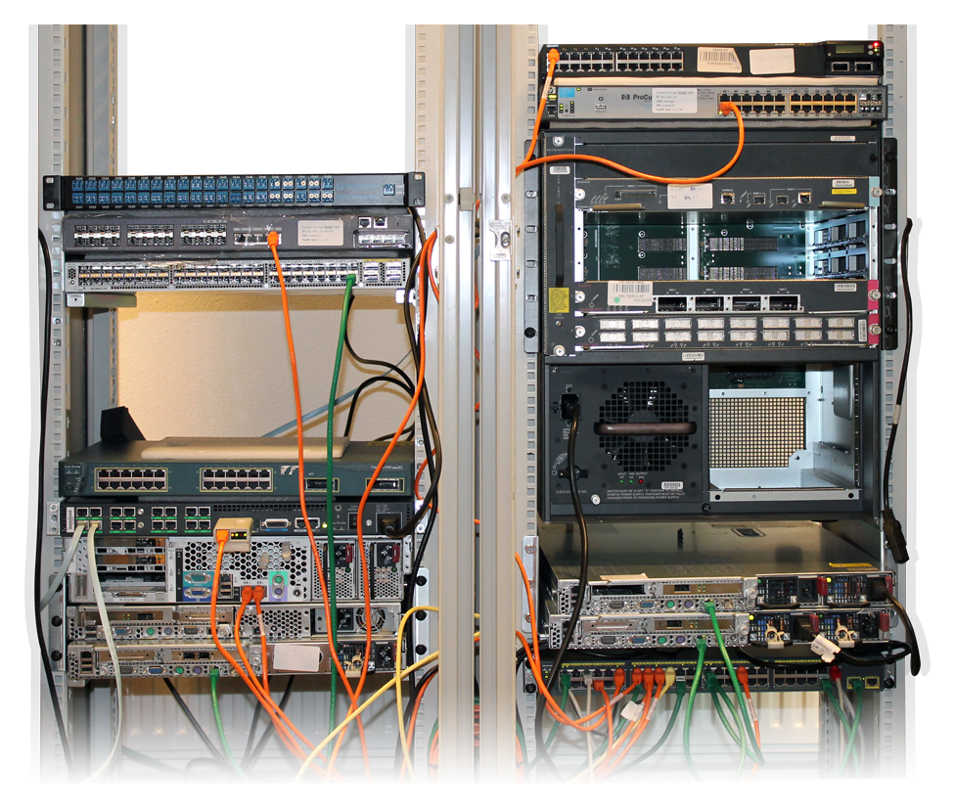
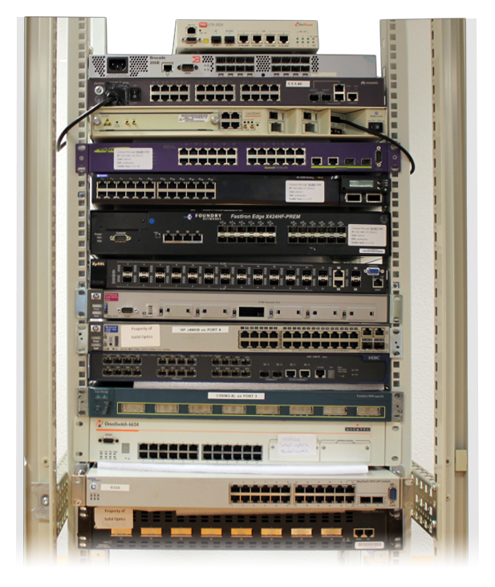
TESTLAB

Slide 8






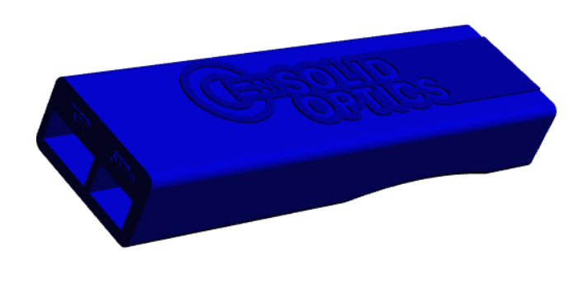



Multi Fiber Tool
Set Brand

Slide 9
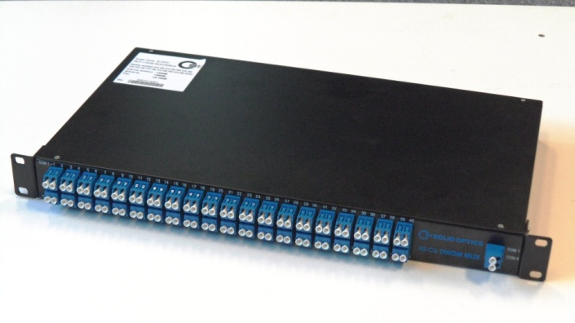
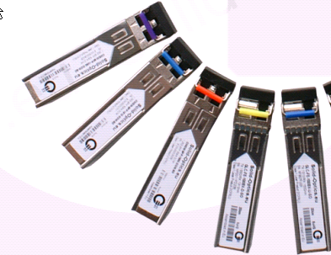
CWDM / DWDM & MUX

Slide 10


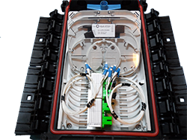
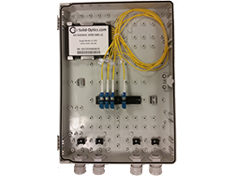
CWDM / DWDM & MUX
CWDM & DWDM Passive MUX
8 to 40Ch
19” rack / Ground enclosure

Slide 11
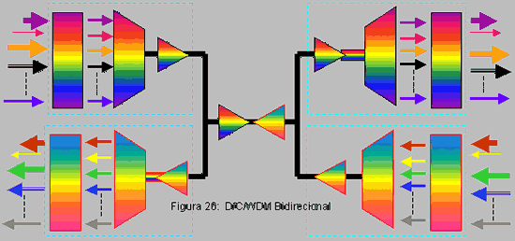
CWDM/DWDM Tecnique
DEMUX and MUX
are in 1 RU 19” box
MUX
DEMUX

Slide 12

CWDM/DWDM Technique
Dark Fiber PAIR

Slide 13
Technique 1
Cross Connect
Dark Fiber
Single stand
1610
1590

Slide 14
Technique 2
CWDM BIDI
CWDM BIDI
Dark fiber
Single strand
1572Tx
1568Tx
1568Rx
1570BX-D
1570BX-U

